Slide 1
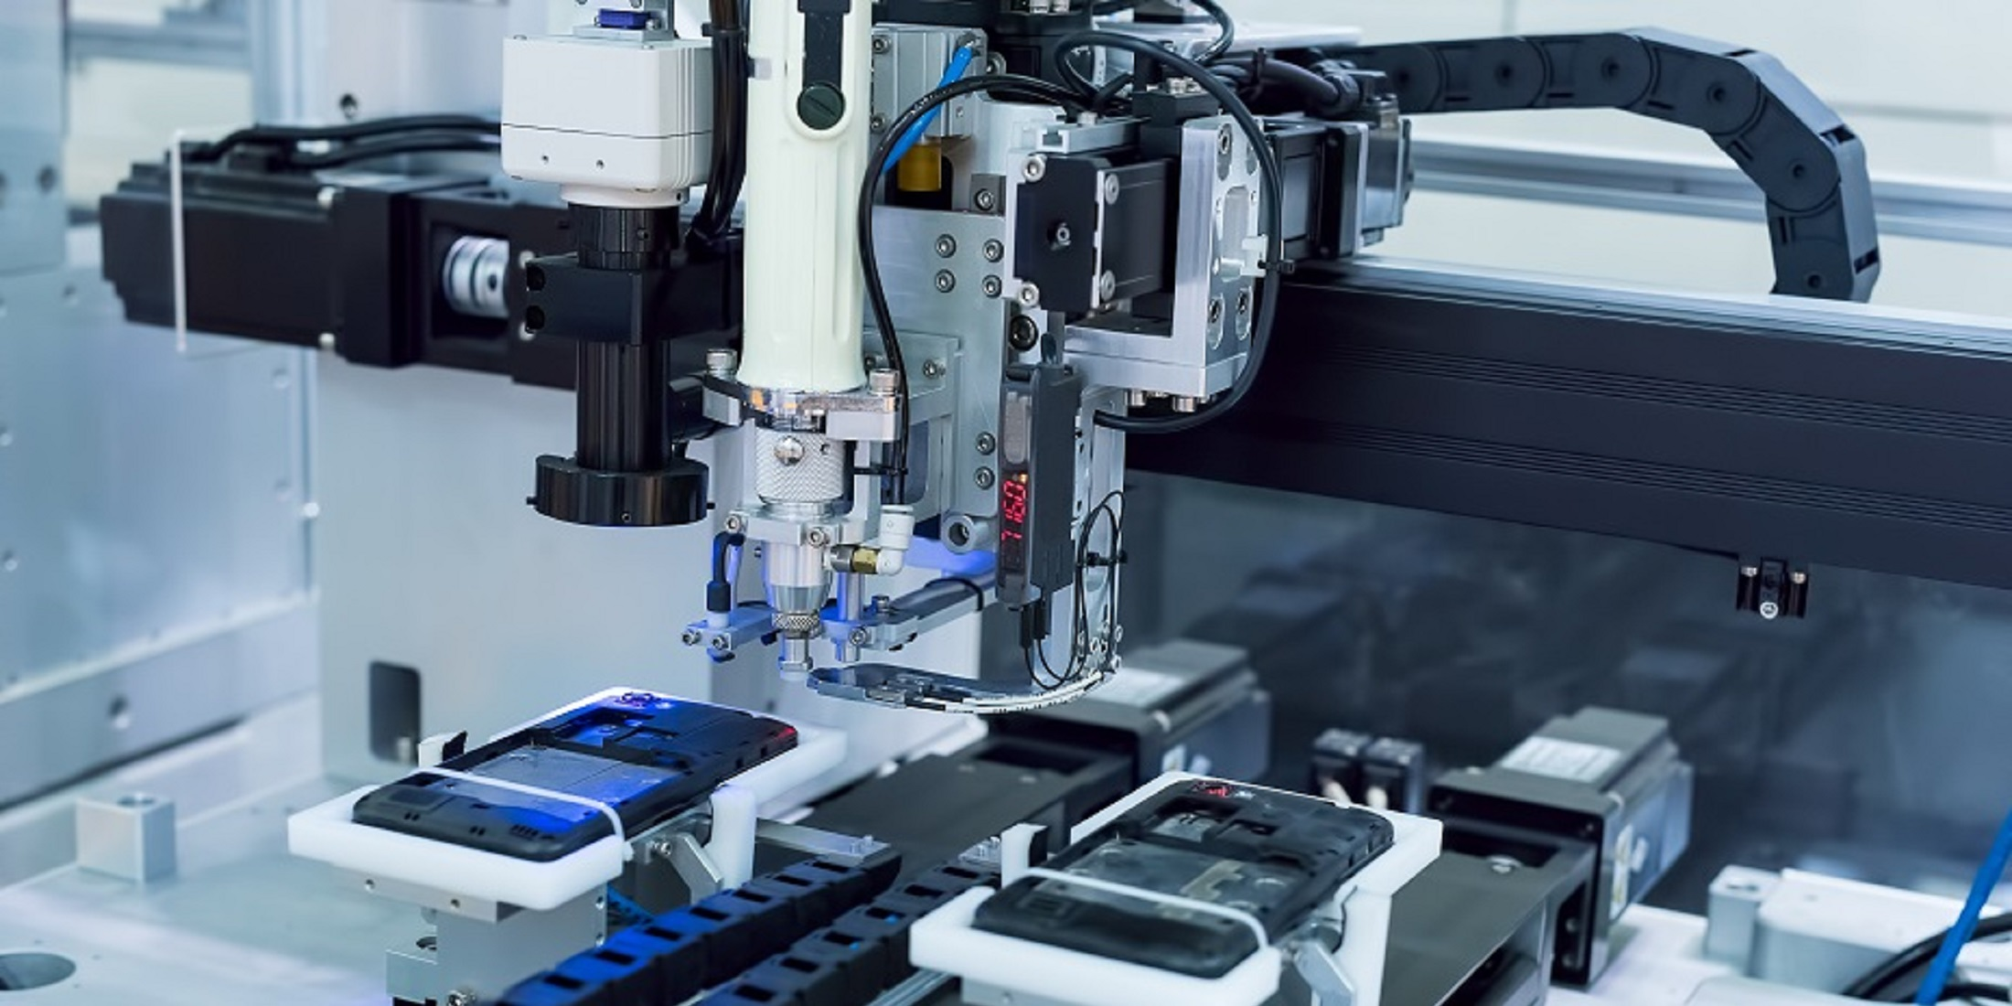

Part Identification
ME 456
Nicholas Hendley

Slide 2
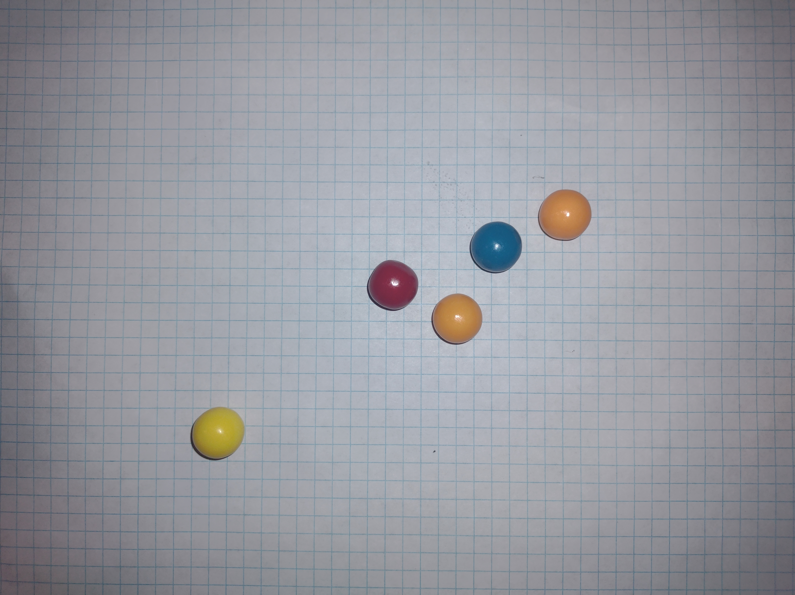
Project Scope
Develop a MATLAB program capable of the following:
Identify all gumballs present in image
Classify each gumball
By color
By diameter
ME 456: Machine Vision

Slide 3
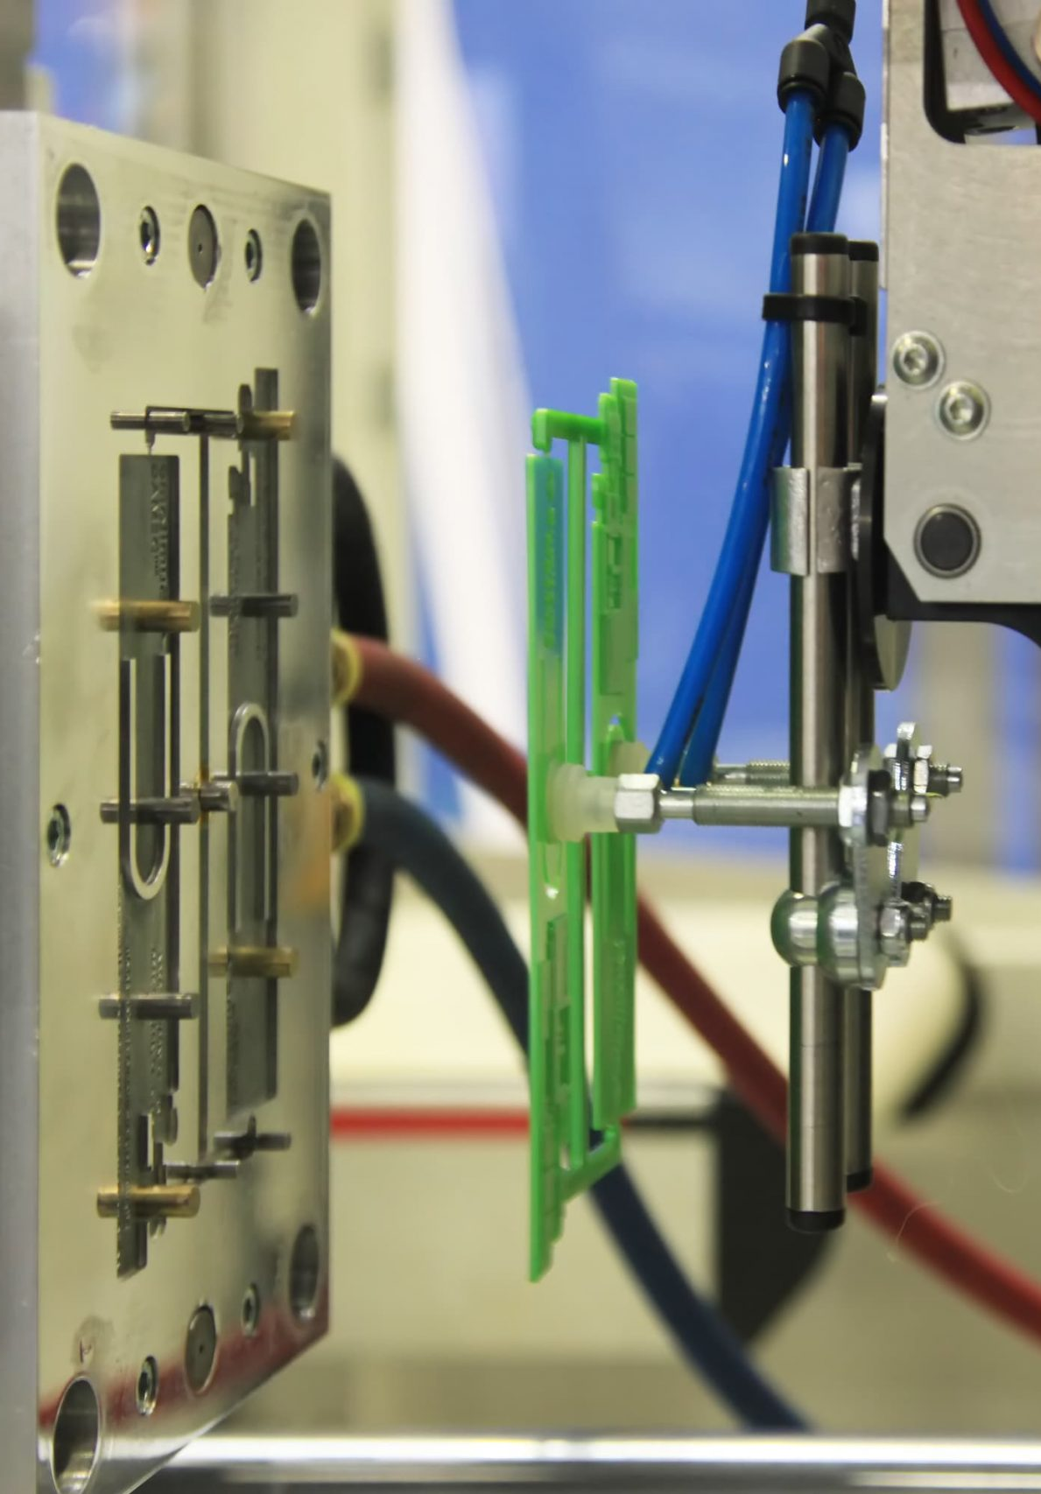
Application
Industrial Automation
Detect faults
Separate variations
ME 456: Machine Vision

Slide 4
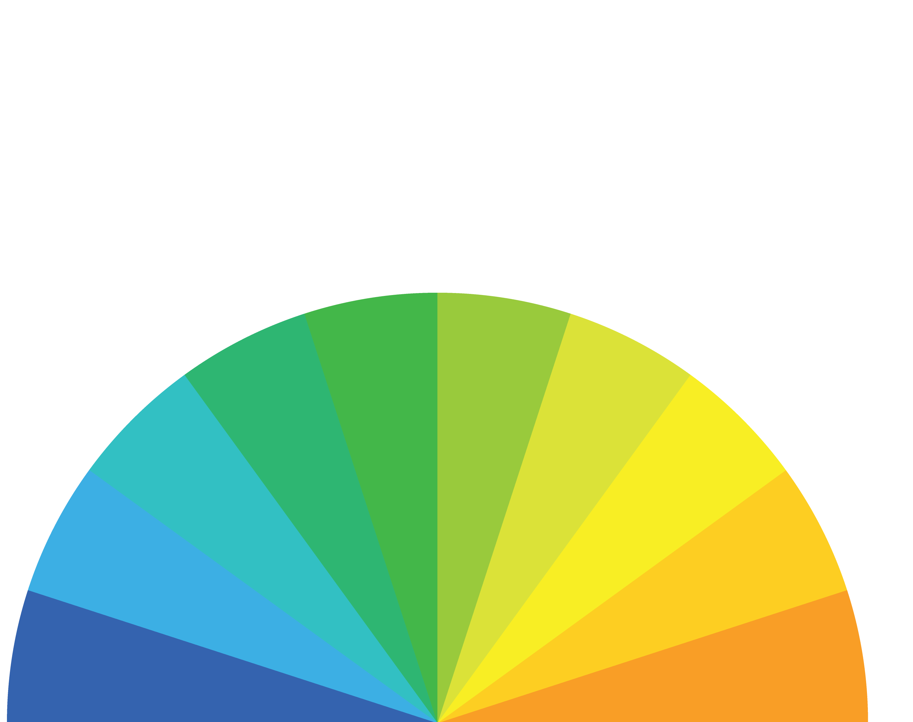




Code Process
Upload
Detect
Measure
Identify
Display
ME 456: Machine Vision
Notes:
Page fades in, red pops up. Only this page

Slide 5
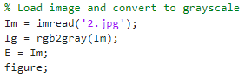
Upload
Convert original image to grayscale
ME 456: Machine Vision
Notes:
Page fades in, red pops up. Only this page

Slide 6
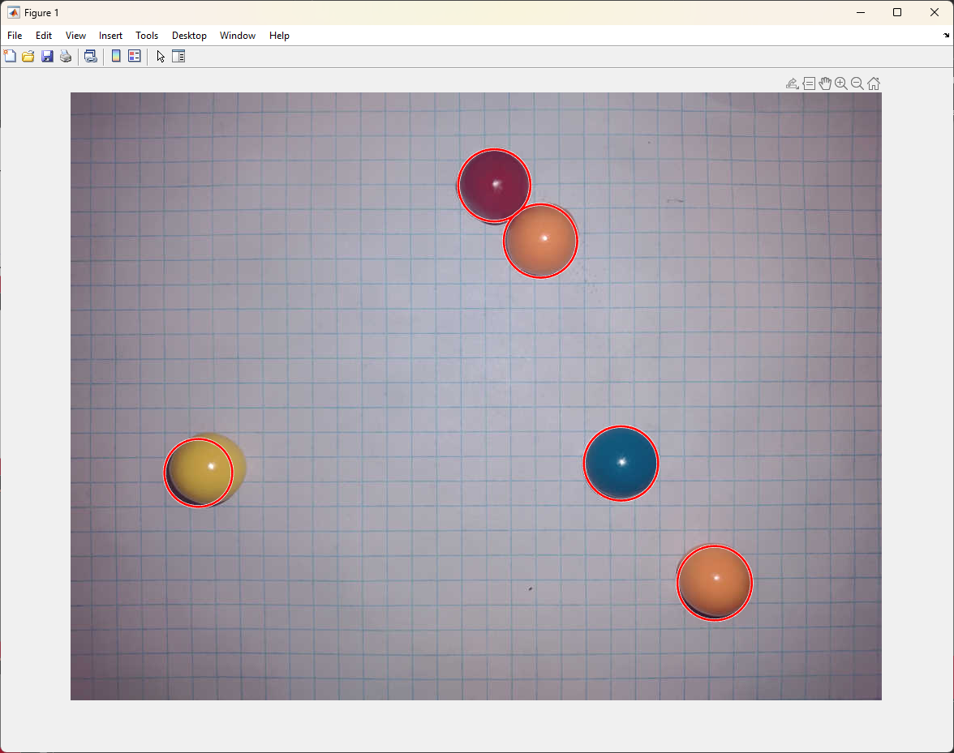

Detect
Hough Transform
Pre-allocates matrix
ME 456: Machine Vision
Notes:
Page fades in, red pops up. Only this page

Slide 7
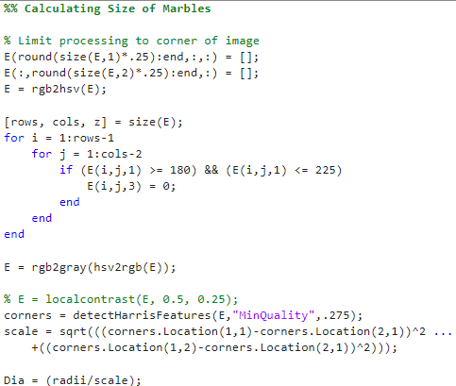
Measure
Known Background
Harris Edge Detection Algorithm
ME 456: Machine Vision
Notes:
Page fades in, red pops up. Only this page

Slide 8
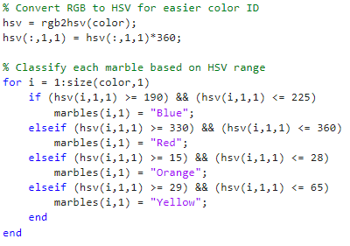
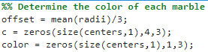
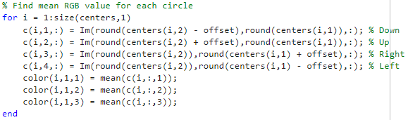
Identify
Determine Offset
Scaled to image size
Calculate Mean RGB
Ensures accuracy by removing hotspots
Color Classification
Convert RGB to HSV for easier color ID
ME 456: Machine Vision
Notes:
New names

Slide 9
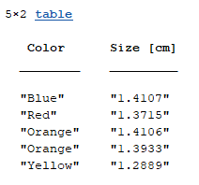
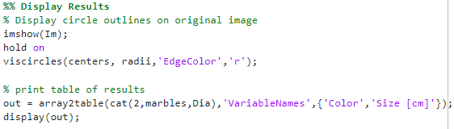
Display
Circles overlaid on original image
Marble color and size output in command line
ME 456: Machine Vision

Slide 10
Shortcomings
Image taking process
Improve lighting
Improve Background contrast
More prop variance
ME 456: Machine Vision
Notes:
Page fades in, red pops up. Only this page

Slide 11
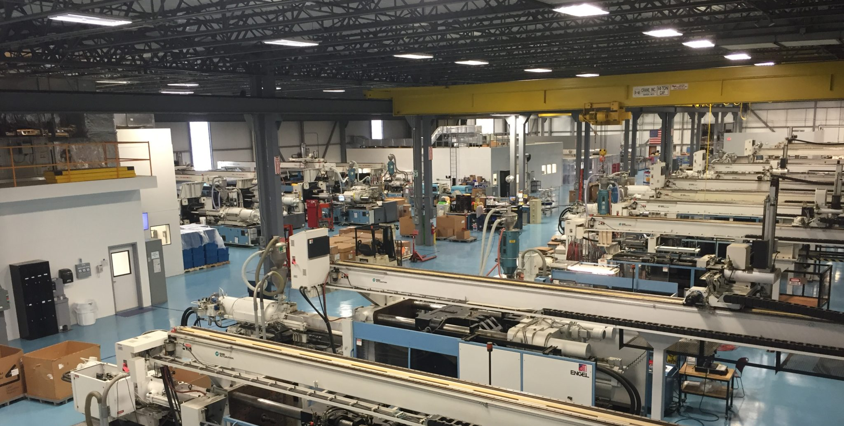
Conclusion
ME 456: Machine Vision

